Slide 1
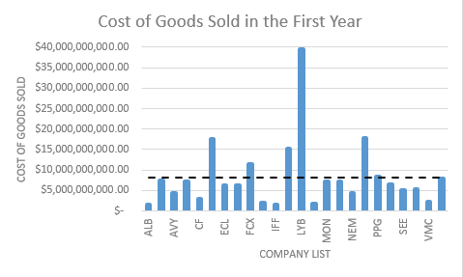
What's the cost of goods sold (COGS) for companies in the materials sector in their first year?
The Mean is the dotted line in the chart which is $8.2m. However, due to the outliers in the data the median ($6.4m) becomes a more appropriate measure of center.
50% of the companies in the Materials sector spend less than $6.4m on COGS in their 1st year while 50% spend more than the $6.4m median.
The standard deviation of $8.1m indicates that the COGS paid by the companies varies greatly and different companies spend more/less than the average of $8.2m.
The range is $38m which means the dataset is very spread out therefore the range is not a reliable measure of variability.

